Slide 1

UNIVERSITY INSTITUTE OF ENGINEERING
COMPUTER SCIENCE ENGINEERING
Master of Engineering
Advanced Python Programming
(23CSH-623)
INTRODUCTION TO PYTHON
DISCOVER . LEARN . EMPOWER

Slide 2
INTRODUCTION TO PYTHON
Course Outcome
Will be covered in this lecture
CO Number | Title | Level
CO1 | To provide conceptual understanding of Python basics. | Remember
CO2 | To develop basic skills of implementing Object Oriented Programming features using - Python | Understand
CO3 | To learn data handling and data visualization in Python. | Analysis and application

Slide 3
Lecture Objectives
To discuss the need of this Subject
To study Features of Python
To write and run a simple Python program
To explain the basic syntax of a Python program
To explain the importance of, and provide examples of, proper programming style and documentation
To explain the differences between syntax errors, runtime errors, and logic errors

Slide 4
Lecture Outcomes
Student will learn the need for this subject
Will get familiarized with Python scripts.
Will learn about the syntaxes and rules for writing Python script programs.
Will be able to write and execute Python scripts with basic functions.

Slide 5
General Purpose Interpreted Object-Oriented
What is Python?
Python is a general purpose programming language. That means you can use Python to write code for any programming tasks. Python are now used in Google search engine, in mission critical projects in NASA, in processing financial transactions at New York Stock Exchange.

Slide 6
General Purpose Interpreted Object-Oriented
What is Python?
Python is interpreted, which means that python code is translated and executed by an interpreter one statement at a time. In a compiled language, the entire source code is compiled and then executed altogether.

Slide 7
General Purpose Interpreted Object-Oriented
What is Python?
Python is an object-oriented programming language. Data in Python are objects created from classes. A class is essentially a type that defines the objects of the same kind with properties and methods for manipulating objects. Object-oriented programming is a powerful tool for developing reusable software.

Slide 8
Python 2 vs. Python 3
Python 3 is a newer version, but it is not backward compatible with Python 2. That means if you write a program using Python 2, it may not work on Python 3.

Slide 9
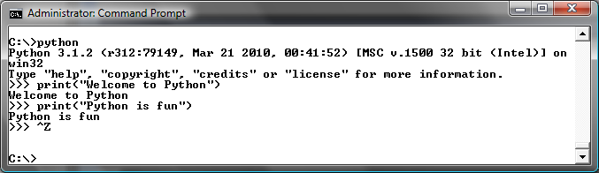
Launch Python

Slide 10
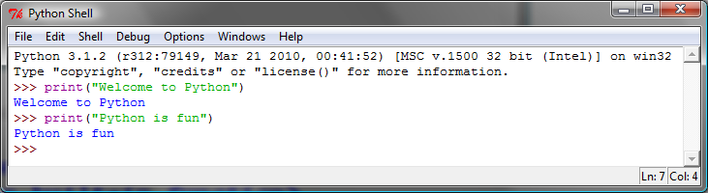
Launch Python IDLE

Slide 11
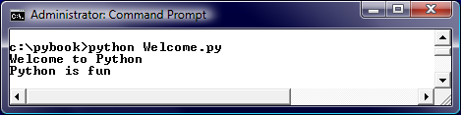
Run Python Script

Slide 12
A Simple Python Program
Listing 1.1
# Display two messages
print("Welcome to Python")
print("Python is fun")
IMPORTANT NOTE:
(1) To enable the buttons, you must download the entire slide file slide.zip and unzip the files into a directory (e.g., c:\slide). (2) You must have installed Python and set python bin directory in the environment path. (3) If you are using Office 2010, check PowerPoint2010.doc located in the same folder with this ppt file.
Welcome
Run

Slide 13

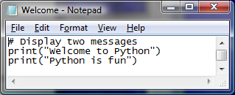
Creating and Editing Using Notepad
To use Notepad, type
notepad Welcome.py
from the DOS prompt.

Slide 14
Trace a Program Execution
animation
Execute a statement
# Display two messages
print("Welcome to Python")
print("Python is fun")

Slide 15
Trace a Program Execution
animation
Execute a statement
# Display two messages
print("Welcome to Python")
print("Python is fun")

Slide 16
Two More Simple Examples
WelcomeWithThreeMessages
Run
ComputeExpression
Run

Slide 17
Anatomy of a Python Program
Statements
Comments
Indentation

Slide 18
Statement
A statement represents an action or a sequence of actions. The statement print("Welcome to Python") in the program in Listing 1.1 is a statement to display the greeting "Welcome to Python“.
# Display two messages
print("Welcome to Python")
print("Python is fun")

Slide 19
Indentation
The indentation matters in Python. Note that the statements are entered from the first column in the new line. It would cause an error if the program is typed as follows:
# Display two messages
print("Welcome to Python")
print("Python is fun")

Slide 20
Special Symbols

Slide 21
Programming Style and Documentation
Appropriate Comments
Proper Indentation and Spacing Lines

Slide 22
Programming Errors
Syntax Errors
Error in code construction
Runtime Errors
Causes the program to abort
Logic Errors
Produces incorrect result

Slide 23
References
Introduction to Programming Using Python by Y. Daniel Liang
Programming and Problem Solving with Python by A. Kamthane

Slide 24
THANK YOU

